Slide 1
Foundations of Cryptography PRG with arbitrary expansion, stream cipher
LiangFeng Zhang
zhanglf@shanghaitech.edu.cn

Slide 2



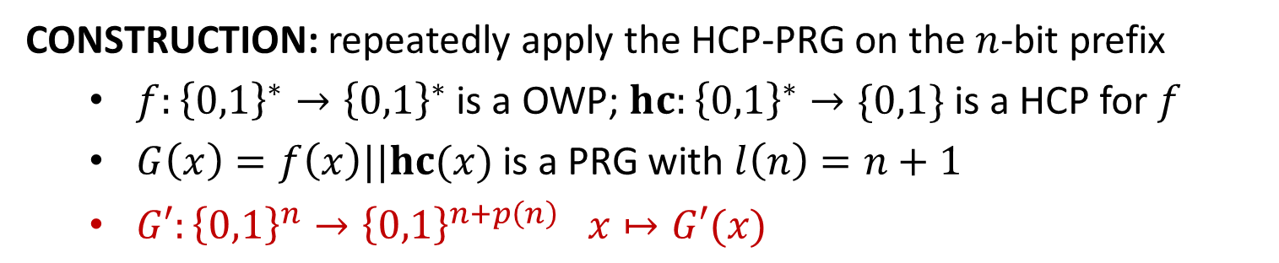
















PRG with Arbitrary Expansion
CONSTRUCTION: repeatedly apply the HCP-PRG on the $n$-bit prefix
$f:{\left\{0,1\right\}}^{∗}→{\left\{0,1\right\}}^{∗}$ is a OWP; $hc:{\left\{0,1\right\}}^{∗}→\{0,1\}$ is a HCP for $f$
$G\left(x\right)=f\left(x\right)||hc(x)$ is a PRG with $l\left(n\right)=n+1$
$G′:{\left\{0,1\right\}}^{n}→{\left\{0,1\right\}}^{n+p\left(n\right)} x↦G′(x)$
$$G′\left\{\begin{aligned} \\ \\ \\ \\ \\ \\ \\ \\ \\ \end{aligned}\right.$$
$$x$$
$$hc(x)$$
$$x$$
$$G↓$$
$$f(x)$$
$$hc(f(x))$$
$$hc(x)$$
$$G↓$$
$$f(f(x))$$
$$⋮$$
$$⋮$$
$$hc(f^{(p\left(n\right)−1)}(x))$$
$$f^{(p\left(n\right))}(x)$$
$$⋯⋯$$
$$G′(x)$$
$n$ bits
$p(n)$ bits
THEOREM: The function $G′$ is a PRG with expansion factor $n+p(n)$.

Slide 3


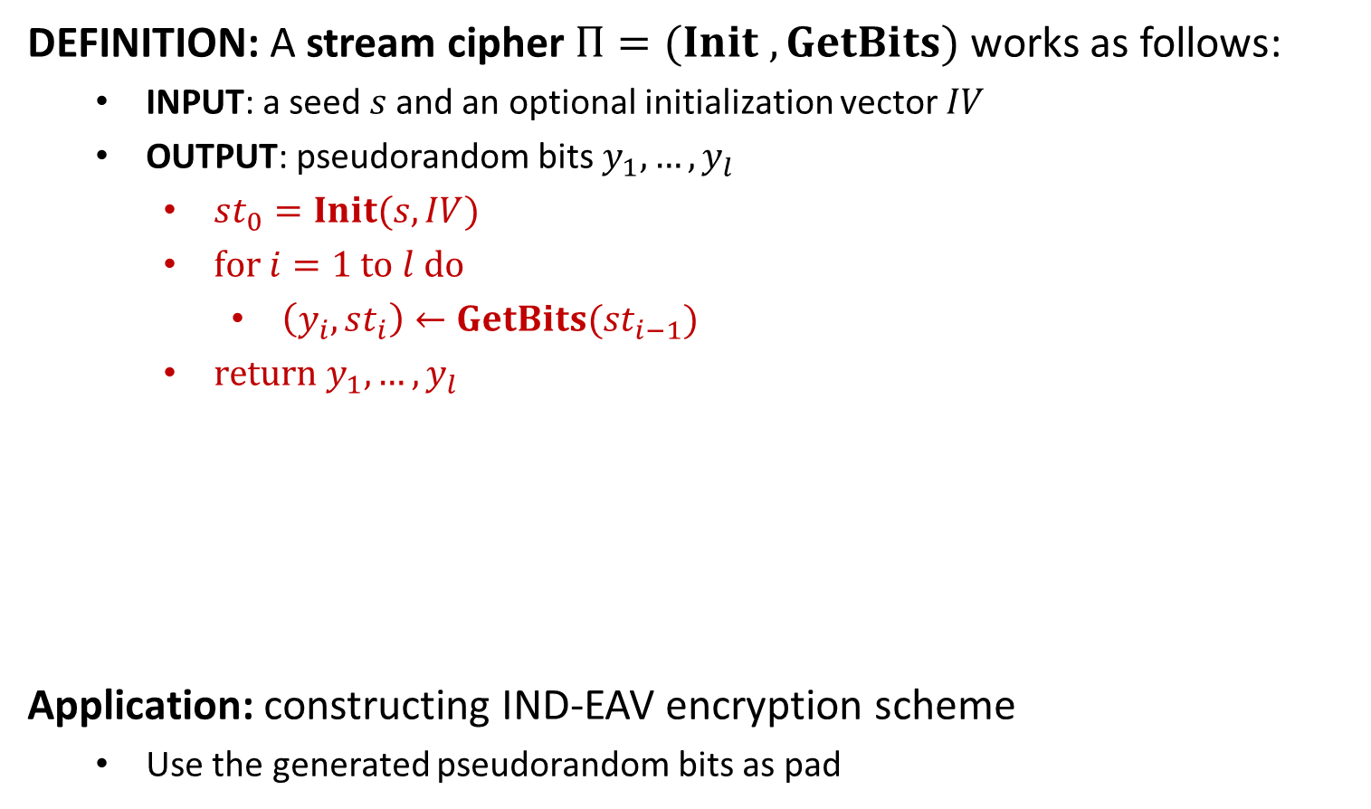











Stream Cipher
DEFINITION: A stream cipher $Π=(Init , GetBits)$ works as follows:
INPUT: a seed$s$and an optional initialization vector $IV$
OUTPUT: pseudorandom bits $y_{1},…,y_{l}$
$st_{0}=Init(s,IV)$
$for i=1 to l do$
$\left(y_{i}, st_{i}\right)←GetBits(st_{i−1})$
$return y_{1},…,y_{l}$
Application: constructing IND-EAV encryption scheme
Use the generated pseudorandom bits as pad
$$s$$
$$Init$$
$$st_{0}$$
$$GetBits$$
$$st_{1}$$
$$GetBits$$
$$st_{2}$$
$$GetBits$$
$$st_{3}$$
$$IV$$
$$⋯$$
$$y_{1}$$
$$y_{2}$$
$$y_{3}$$
$$⋯$$

